Slide 1


SCHOOL OF MANAGEMENT
INTERNSHIP PRESENTATION
MBA III SEMESTER
DATE - 13/09/2024

Slide 2


INTERNSHIP IN
FIPCHAIN TECHNOLOGY PVT LTD
BY
PRIYADHARSHINI M
II MBA
125071061

Slide 3

OBJECTIVES
Acquire practical experience in data analysis
Build expertise in tools such as Power BI, Jupyter Notebooks, and Excel
Work with large datasets to extract valuable insights
Improve decision-making abilities within a real-world business environment.

Slide 4
ABOUT THE COMPANY
Fipchain Technology Pvt Ltd has emerged to revolutionize the unexplored facets of the Film and Entertainment industry by offering innovative B2B, B2C, and Fintech solutions.
One of its key platforms, Producerbazaar.com, is a cutting-edge marketplace that merges WEB2 and WEB3 technologies.
It seamlessly integrates blockchain to connect creators, producers, aggregators, and buyers for the purchase and sale of movie-related Intellectual Property rights globally.
Website : https://www.producerbazaar.com/
Industry : Technology, Information and Media
Founded : 2021

Slide 5

VISION AND MISSION
Vision
To be the global leader in transforming IP rights trading, creating a transparent and secure digital marketplace for the entertainment industry.
Mission
To revolutionize the movie industry by providing a blockchain-powered platform that empowers creators and streamlines IP rights transactions.

Slide 6

AREA OF WORK
Gain hands-on experience in data analysis.
Develop proficiency in tools like Power BI, Jupyter Notebooks, and Excel
Analyze large datasets to derive actionable insights
Enhance decision-making skills in a real-world business context

Slide 7

PRODUCT AND SERVICE
MAIN PRODUCT
Producerbazaar.com – A blockchain-based platform for movie intellectual property transactions.
SERVICES
B2B, B2C, and fintech solutions for the entertainment industry.

Slide 8
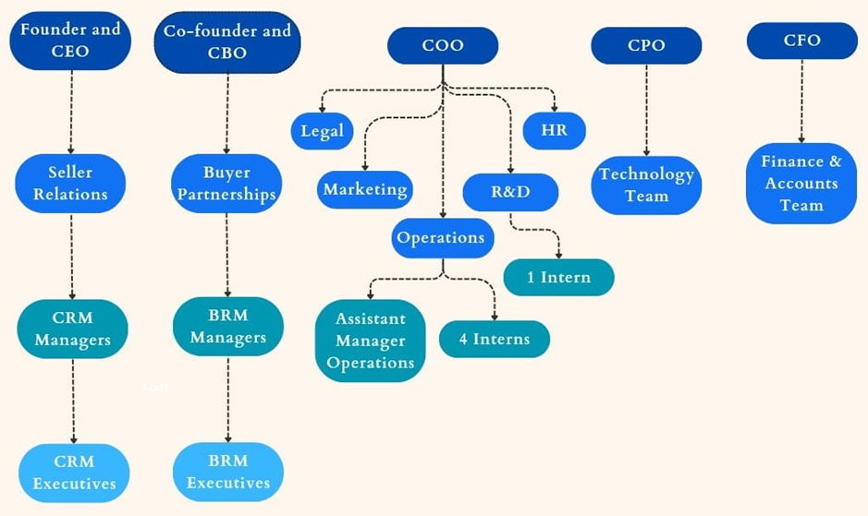
ORGANISATIONAL STRUCTURE

Slide 9
JOB ROLE
POSITION
Frontend Data Analyst
RESPONSIBILITIES
Data cleaning and preparation.
CRM tool analysis (Zoho CRM, HubSpot, Microsoft Dynamics)
Exploratory Data Analysis (EDA) using Power BI.
Evaluating CRM tools and generating strategic insights for the company.

Slide 10

KEY SKILL LEARNT
Proficiency in Power BI for data visualization
Data cleaning and preparation techniques
Exploratory Data Analysis (EDA).

Slide 11
INTERN’S KEY OBSERVATION
Data cleaning is a critical step for accurate analysis.
The entertainment industry values insights from data-driven decision-making.

Slide 12

LEASON LEARNT
The importance of data accuracy and integrity in real-world business scenarios.
Practical applications of data analysis in the entertainment industry.

Slide 13
FEEDBACK TO THE ORGANISATION
Positive experience in contributing to real-world data analysis projects.
Improved understanding of CRM tools and their business impact.
Suggestions for enhancing data privacy protocols in CRM usage.

Slide 14
Thank you!

